Slide 1
Chapter 1: Introduction

Slide 2
Outline
The Need for Databases
Data Models
Relational Databases
Database Design
Storage Manager
Query Processing
Transaction Manager

Slide 3
Database Management System (DBMS)
DBMS contains information about a particular enterprise
  Collection of interrelated data
  Set of programs to access the data
  An environment that is both convenient and efficient to use
Database Applications:
  Banking: transactions
  Airlines: reservations, schedules
  Universities: registration, grades
  Sales: customers, products, purchases
  Online retailers: order tracking, customized recommendations
  Manufacturing: production, inventory, orders, supply chain
  Human resources: employee records, salaries, tax deductions
Databases can be very large.
Databases touch all aspects of our lives

Slide 4
University Database Example
Application program examples
  Add new students, instructors, and courses
  Register students for courses, and generate class rosters
  Assign grades to students, compute grade point averages (GPA) and generate transcripts
In the early days, database applications were built directly on top of file systems

Slide 5
Purpose of Database management systems
Database management systems were developed to handle the following difficulties of typical file-processing systems supported by conventional operating systems:
Drawbacks of using file systems to store data
Data redundancy and inconsistency
  Multiple file formats, duplication of information in different files
Difficulty in accessing data
  Need to write a new program to carry out each new task
Data isolation
  Multiple files and formats
Integrity problems
  Integrity constraints (e.g., account balance > 0) become “buried” in program code rather than being stated explicitly
  Hard to add new constraints or change existing ones

Slide 6
Drawbacks of using file systems to store data (Cont.)
Atomicity of updates
  Failures may leave database in an inconsistent state with partial updates carried out
  Example: Transfer of funds from one account to another should either complete or not happen at all
Concurrent access by multiple users
  Concurrent access needed for performance
  Uncontrolled concurrent accesses can lead to inconsistencies
    Example: Two people reading a balance (say 100) and updating it by withdrawing money (say 50 each) at the same time
Security problems
  Hard to provide user access to some, but not all, data
Database systems offer solutions to all the above problems

Slide 7
Database Users
Users are differentiated by the way they expect to interact with the system.
Application programmers: interact with system through DML calls.
Application Programmers are responsible for writing application programs that use the data­base. These programs could be written in General Purpose Programming languages such as Visual Basic, Developer, C, FORTRAN, COBOL etc. to manipulate the database. These application programs operate on the data to perform various operations such as retaining information, creating new informa­tion, deleting or changing existing information.

Slide 8
Specialized users: write specialized database applications that do not fit into the traditional data processing framework ,
Among these applications are computer aided-design systems, knowledge-base and expert systems etc.
Sophisticated users: sophisticated users form their requests in a database query language and submit them to a query processor to make the storage manager understand the requests. Analysts who submit queries to explore data in the database fall in this category.

Slide 9
Naive users: This type of users generally interacts with the system through previously created programs. Such as, a user may use the system to transfer some balance from one account to another. This will be done a program, like ‘Transfer’. The user will only fill some required fields of the program like the balance, the accounts etc. The typical interfaces for these users are forms including some required fields to be filled.

Slide 10

View of Data
An architecture for a database system

Slide 11
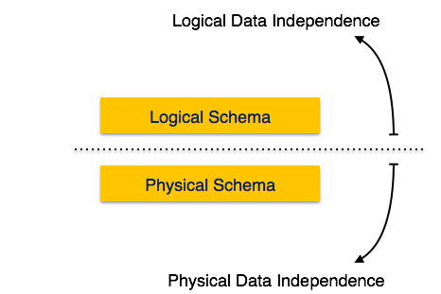
If a database system is not multi-layered, then it becomes difficult to make any changes in the database system
Data Independence
A database system normally contains a lot of data in addition to users’ data. For example, it stores data about data, known as metadata, to locate and retrieve data easily. It is rather difficult to modify or update a set of metadata once it is stored in the database. But as a DBMS expands, it needs to change over time to satisfy the requirements of the users. If the entire data is dependent, it would become a tedious and highly complex job.

Slide 12
Data Independence conti..
Metadata itself follows a layered architecture, so that when we change data at one layer, it does not affect the data at another level. This data is independent but mapped to each other.
Logical Data Independence
Logical data is data about database, that is, it stores information about how data is managed inside. For example, a table (relation) stored in the database and all its constraints, applied on that relation.
Logical data independence is a kind of mechanism, which liberalizes itself from actual data stored on the disk. If we do some changes on table format, it should not change the data residing on the disk.

Slide 13
Physical Data Independence
All the schemas are logical, and the actual data is stored in bit format on the disk. Physical data independence is the power to change the physical data without impacting the schema or logical data.
For example, in case we want to change or upgrade the storage system itself − suppose we want to replace hard-disks with SSD − it should not have any impact on the logical data or schemas.

Slide 14
Database Schema
A database schema is the skeleton structure that represents the logical view of the entire database. It defines how the data is organized and how the relations among them are associated. It formulates all the constraints that are to be applied on the data.
A database schema defines its entities and the relationship among them. It contains a descriptive detail of the database, which can be depicted by means of schema diagrams. It’s the database designers who design the schema to help programmers understand the database and make it useful.

Slide 15
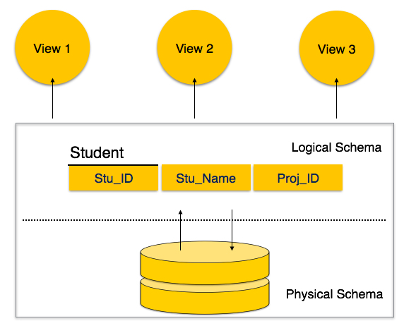

Slide 16
A database schema can be divided broadly into two categories −
Physical Database Schema − This schema pertains to the actual storage of data and its form of storage like files, indices, etc. It defines how the data will be stored in a secondary storage.
Logical Database Schema − This schema defines all the logical constraints that need to be applied on the data stored. It defines tables, views, and integrity constraints.

Slide 17
Database Languages
DDL
DDLs are used to define the metadata of the database. i.e.; using this, we create schema, tables, constraints, indexes in the database. DDLs are also used to modify Schema, tables index etc. Basically, using DDL statements, we create skeleton of the database. It helps to store the metadata information like number of schemas and tables, their names, columns in each table, indexes, constraints etc in the database.
CREATE – to create database and its objects like (table, index, views, store procedure, function and triggers)
ALTER – alters the structure of the existing database
DROP – delete objects from the database
TRUNCATE – remove all records from a table, including all spaces allocated for the records are removed
COMMENT – add comments to the data dictionary
RENAME – rename an object

Slide 18
DML
When we have to insert records into table or get specific record from the table, or need to change some record, or delete some record or perform any other actions on records in the database, we need to have some media to perform it. DML helps to handle user requests. It helps to insert, delete, update, and retrieve the data from the database.
SELECT – retrieve data from the a database
INSERT – insert data into a table
UPDATE – updates existing data within a table
DELETE – Delete all records from a database table

Slide 19
DCL
languages are used to control the user access to the database, tables, views, procedures, functions and packages. They give different levels of access to the objects in the database
Suppose we have created a table STUDENT in the database. Now who can view or access these tables? No one other than who has created it! We need to explicitly tell the database, who can view this table and what kind of access like read, write, delete should be given to the other users.
Similarly, some of the users who were accessing this table have left the organization. But still they have access to this table, which is not acceptable. Hence we need to remove their access on such tables and database.
GRANT – allow users access privileges to database
REVOKE – withdraw users access privileges given by using the GRANT command

Slide 20
TCL is short name of Transaction Control Language which deals with transaction within a database.
Suppose we have inserted some records in to Employee table. Now we need to save them. How? Similarly, we have updated something wrong on the table. After updating we realized that its wrong. Now we need to unsave the changes that have been done. How? We have deleted something or inserted something which is not correct. It has to be undone. All these
COMMIT – commits a Transaction
ROLLBACK – rollback a transaction in case of any error occurs
SAVEPOINT – to rollback the transaction making points within groups
SET TRANSACTION – specify characteristics for the transaction
saving and undoing the tasks can be done by TCL.

Slide 21
DATABASE ADMINISTRATOR
The life cycle of database starts from designing, implementing to administration of it.
A database for any kind of requirement needs to be designed perfectly so that it should work without any issues.
Once all the design is complete, it needs to be installed. Once this step is complete, users start using the database.
The database grows as the data grows in the database.
When the database becomes huge, its performance comes down. Also accessing the data from the database becomes challenge.
There will be unused memory in database, making the memory inevitably huge. These administration and maintenance of database is taken care by database Administrator
A DBA has many responsibilities. A good performing database is in the hands of DBA.

Slide 22
Installing and upgrading the DBMS Servers: - DBA is responsible for installing a new DBMS server for the new projects. He is also responsible for upgrading these servers as there are new versions comes in the market or requirement. If there is any failure in upgradation of the existing servers, he should be able revert the new changes back to the older version, thus maintaining the DBMS working. He is also responsible for updating the service packs/ hot fixes/ patches to the DBMS servers.
Design and implementation: - Designing the database and implementing is also DBA’s responsibility. He should be able to decide proper memory management, file organizations, error handling, log maintenance etc for the database.
Performance tuning: - Since database is huge and it will have lots of tables, data, constraints and indices, there will be variations in the performance from time to time. Also, because of some designing issues or data growth, the database will not work as expected. It is responsibility of the DBA to tune the database performance. He is responsible to make sure all the queries and programs works in fraction of seconds

Slide 23
Migrate database servers: - Sometimes, users using oracle would like to shift to SQL server or Netezza. It is the responsibility of DBA to make sure that migration happens without any failure, and there is no data loss.
Backup and Recovery: - Proper backup and recovery programs needs to be developed by DBA and has to be maintained him. This is one of the main responsibilities of DBA. Data/objects should be backed up regularly so that if there is any crash, it should be recovered without much effort and data loss.
Security: - DBA is responsible for creating various database users and roles, and giving them different levels of access rights.
Documentation: - DBA should be properly documenting all his activities so that if he quits or any new DBA comes in, he should be able to understand the database without any effort. He should basically maintain all his installation, backup, recovery, security methods. He should keep various reports about database performance.
There are different kinds of DBA depending on the responsibility that he owns

Slide 28
Levels of Abstraction
Physical level: describes how a record (e.g., instructor) is stored.
Logical level: describes data stored in database, and the relationships among the data.
  type instructor = record
  ID : string;
  name : string;
  dept_name : string;
  salary : integer;
        end;
View level: application programs hide details of data types. Views can also hide information (such as an employee’s salary) for security purposes.

Slide 29
View of Data
An architecture for a database system

Slide 30
Instances and Schemas
Similar to types and variables in programming languages
Logical Schema – the overall logical structure of the database
  Example: The database consists of information about a set of customers and accounts in a bank and the relationship between them
    Analogous to type information of a variable in a program
Physical schema– the overall physical structure of the database
Instance – the actual content of the database at a particular point in time
  Analogous to the value of a variable
Physical Data Independence – the ability to modify the physical schema without changing the logical schema
  Applications depend on the logical schema
  In general, the interfaces between the various levels and components should be well defined so that changes in some parts do not seriously influence others.

Slide 31
Data Models
A collection of tools for describing
  Data
  Data relationships
  Data semantics
  Data constraints
Relational model
Entity-Relationship data model (mainly for database design)
Object-based data models (Object-oriented and Object-relational)
Semistructured data model (XML)
Other older models:
  Network model
  Hierarchical model

Slide 32

Relational Model
All the data is stored in various tables.
Example of tabular data in the relational model
Columns
Rows

Slide 33
A Sample Relational Database

Slide 34
Data Definition Language (DDL)
Specification notation for defining the database schema
  Example: create table instructor (
  ID char(5),
  name varchar(20),
  dept_name varchar(20),
  salary numeric(8,2))
DDL compiler generates a set of table templates stored in a data dictionary
Data dictionary contains metadata (i.e., data about data)
  Database schema
  Integrity constraints
    Primary key (ID uniquely identifies instructors)
  Authorization
    Who can access what

Slide 35
Data Manipulation Language (DML)
Language for accessing and manipulating the data organized by the appropriate data model
  DML also known as query language
Two classes of languages
  Pure – used for proving properties about computational power and for optimization
    Relational Algebra
    Tuple relational calculus
    Domain relational calculus
  Commercial – used in commercial systems
    SQL is the most widely used commercial language

Slide 36
SQL
The most widely used commercial language
SQL is NOT a Turing machine equivalent language
SQL is NOT a Turing machine equivalent language
To be able to compute complex functions SQL is usually embedded in some higher-level language
Application programs generally access databases through one of
  Language extensions to allow embedded SQL
  Application program interface (e.g., ODBC/JDBC) which allow SQL queries to be sent to a database

Slide 37
Database Design
The process of designing the general structure of the database:
Logical Design – Deciding on the database schema. Database design requires that we find a “good” collection of relation schemas.
  Business decision – What attributes should we record in the database?
  Computer Science decision – What relation schemas should we have and how should the attributes be distributed among the various relation schemas?
Physical Design – Deciding on the physical layout of the database

Slide 38

Database Design (Cont.)
Is there any problem with this relation?

Slide 39
Design Approaches
Need to come up with a methodology to ensure that each of the relations in the database is “good”
Two ways of doing so:
  Entity Relationship Model (Chapter 7)
    Models an enterprise as a collection of entities and relationships
    Represented diagrammatically by an entity-relationship diagram:
  Normalization Theory (Chapter 8)
    Formalize what designs are bad, and test for them

Slide 40
Object-Relational Data Models
Relational model: flat, “atomic” values
Object Relational Data Models
  Extend the relational data model by including object orientation and constructs to deal with added data types.
  Allow attributes of tuples to have complex types, including non-atomic values such as nested relations.
  Preserve relational foundations, in particular the declarative access to data, while extending modeling power.
  Provide upward compatibility with existing relational languages.

Slide 41
XML: Extensible Markup Language
Defined by the WWW Consortium (W3C)
Originally intended as a document markup language not a database language
The ability to specify new tags, and to create nested tag structures made XML a great way to exchange data, not just documents
XML has become the basis for all new generation data interchange formats.
A wide variety of tools is available for parsing, browsing and querying XML documents/data

Slide 42
Database Engine
Storage manager
Query processing
Transaction manager

Slide 43
Storage Management
Storage manager is a program module that provides the interface between the low-level data stored in the database and the application programs and queries submitted to the system.
The storage manager is responsible to the following tasks:
  Interaction with the OS file manager
  Efficient storing, retrieving and updating of data
Issues:
  Storage access
  File organization
  Indexing and hashing

Slide 44

Query Processing
1. Parsing and translation
2. Optimization
3. Evaluation

Slide 45
Query Processing (Cont.)
Alternative ways of evaluating a given query
  Equivalent expressions
  Different algorithms for each operation
Cost difference between a good and a bad way of evaluating a query can be enormous
Need to estimate the cost of operations
  Depends critically on statistical information about relations which the database must maintain
  Need to estimate statistics for intermediate results to compute cost of complex expressions

Slide 46
Transaction Management
What if the system fails?
What if more than one user is concurrently updating the same data?
A transaction is a collection of operations that performs a single logical function in a database application
Transaction-management component ensures that the database remains in a consistent (correct) state despite system failures (e.g., power failures and operating system crashes) and transaction failures.
Concurrency-control manager controls the interaction among the concurrent transactions, to ensure the consistency of the database.

Slide 47

Database Users and Administrators
Database

Slide 48

Database System Internals

Slide 49
Database Architecture
The architecture of a database systems is greatly influenced by
the underlying computer system on which the database is running:
Centralized
Client-server
Parallel (multi-processor)
Distributed

Slide 50
History of Database Systems
1950s and early 1960s:
  Data processing using magnetic tapes for storage
    Tapes provided only sequential access
  Punched cards for input
Late 1960s and 1970s:
  Hard disks allowed direct access to data
  Network and hierarchical data models in widespread use
  Ted Codd defines the relational data model
    Would win the ACM Turing Award for this work
    IBM Research begins System R prototype
    UC Berkeley begins Ingres prototype
  High-performance (for the era) transaction processing

Slide 51
History (cont.)
1980s:
  Research relational prototypes evolve into commercial systems
    SQL becomes industrial standard
  Parallel and distributed database systems
  Object-oriented database systems
1990s:
  Large decision support and data-mining applications
  Large multi-terabyte data warehouses
  Emergence of Web commerce
Early 2000s:
  XML and XQuery standards
  Automated database administration
Later 2000s:
  Giant data storage systems
    Google BigTable, Yahoo PNuts, Amazon, ..

Slide 52
End of Chapter 1

Slide 53
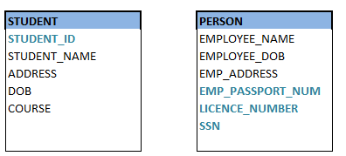
Any attribute in the table which uniquely identifies each record in the table is called key. It can be a single attribute or a combination of attributes. For example, in STUDENT table, STUDENT_ID is a key, since it is unique for each student. In PERSON table, his passport number, driving license number, phone number, SSN, email address is keys since they are unique for each person.

Slide 54
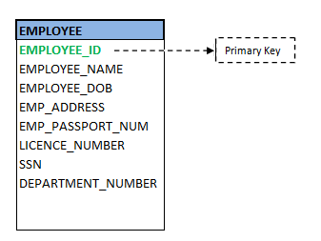
Primary Key
It is the first and foremost key which is used to uniquely identify a record. It can be a single attribute or a combination of attributes. For an entity, there could be multiple keys as we saw in PERSON table. Most suitable key from those lists becomes a primary key. In the Person table above, we can select SSN as primary key, since it is unique for each person. We can even select Passport Number or license number as primary key as they are also unique for a person. However, selection of primary key for each entity is based on requirement and developer.

Slide 55
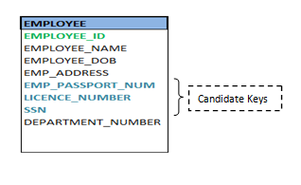
Candidate Key
As we discussed above, an employee is identified by his ID in his office. Apart from his ID, does he have any other unique keys, so that he can be identified from others? Yes, he has passport number, PAN number, SSN number (if applicable), driving license number, email address etc. These are also identifies specific person uniquely. But we can choose any one of these unique attribute as primary key in the table. Rest of the attributes, which holds as strong as primary key are considered as Candidate key/secondary key. In our example of employee table, EMPLOYEE_ID is best suited for primary key as its from his own employer. Rest of the attributes like passport number, SSN, license Number etc are considered as candidate key.

Slide 56
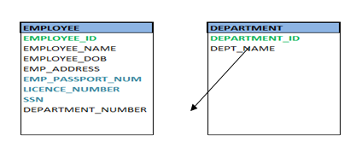
Foreign key
In a company there would be different departments - Accounting, Human Resource (HR), development, Quality, etc. An employee, who works for that company, works in specific department. But we know that employee and department are two different entities. So we cannot store his department information in employee table. Instead what we do is we link these two tables by means of primary key of one of the table i.e.; in this case, we pick the primary key of department table - DEPARTMENT_ID and add it as a new attribute/column in the Employee table. Now DEPARTMENT_ID is a foreign key for Employee table, and both the tables are related!

Slide 57
Constraints are the conditions forced on the columns of the table to meet the data integrity. We have seen above what types of data integrities exists in the database. Now let see what constraints can be applied on tables so that data integrity is met.
NOT NULL
This constraint forces the column to have non-null value. We cannot enter/update any NULL value into such columns. It must have valid value all the time. For example, each student in STUDENT table should have class specified. No student can exist without class. Hence class column in the STUDENT table can be made NOT NULL.
CREATE TABLE STUDENT (STUDENT_ID NUMBER (10) NOT NULL
STUDENT_NAME VARCHAR2 (50) NOT NULL,
AGE NUMBER);

Slide 58
UNIQUE

